Slide 1
Transform in Computer Vision
分享人：梁瑛平 时间：2021-04-11

Slide 2
1
Introduction
Please Enter Your Title Here
2
目录
Image Classification
Please Enter Your Title Here
3
CONTENTS
Object Detection
Please Enter Your Title Here
4
Semantic Segmentation
Please Enter Your Title Here

Slide 3
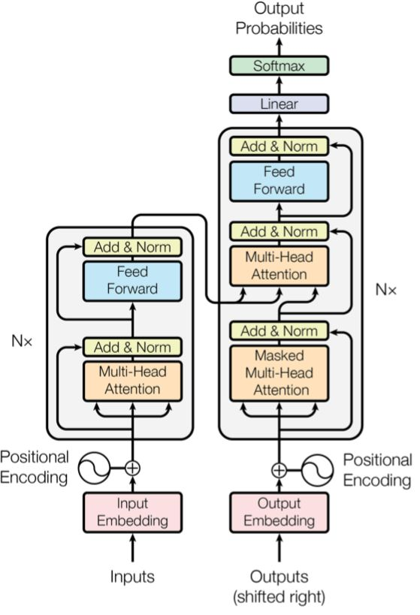
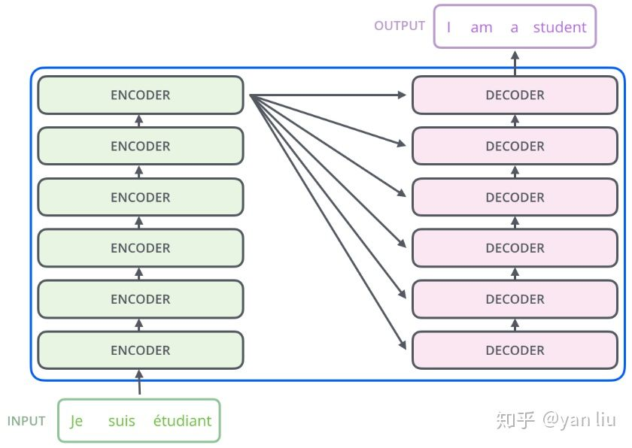

Introduction
《Attention Is All You Need》

Slide 4
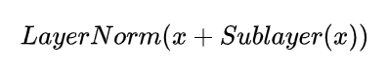
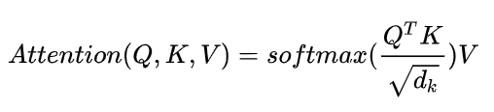
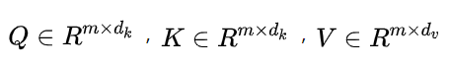
Introduction
《Attention Is All You Need》
Encoder：
Attention：

Slide 5
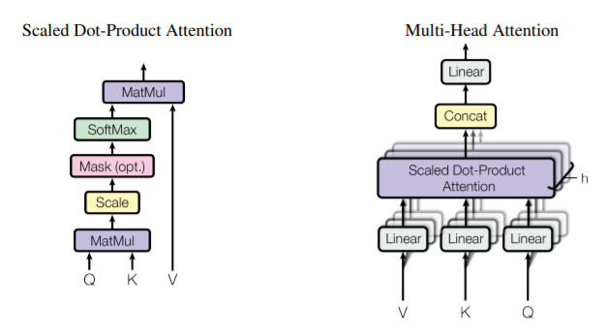
Introduction
《Attention Is All You Need》

Slide 6
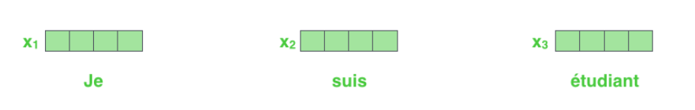
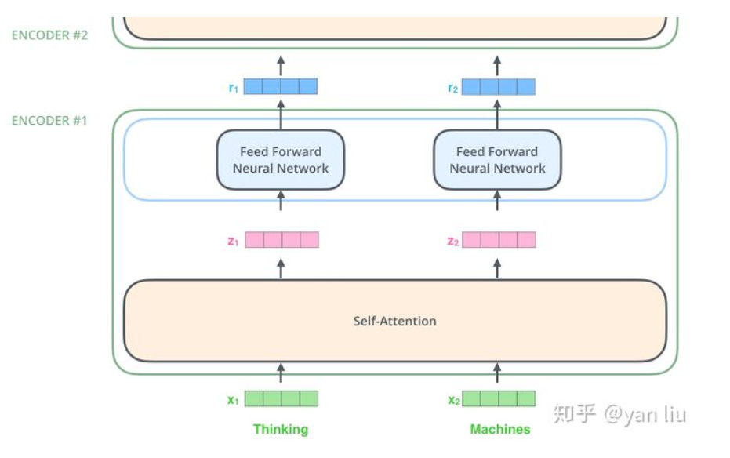
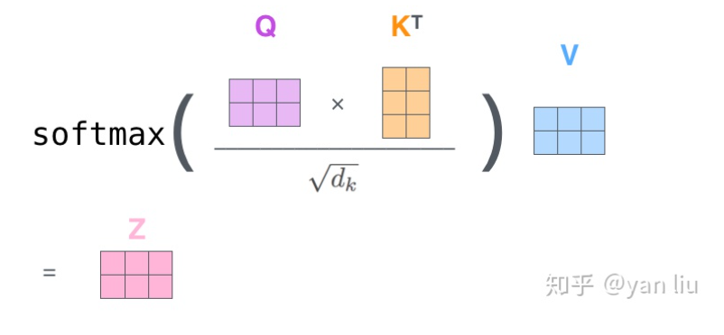


Introduction
《Attention Is All You Need》
Input：
Encoders：
Self-Attention：

Slide 7
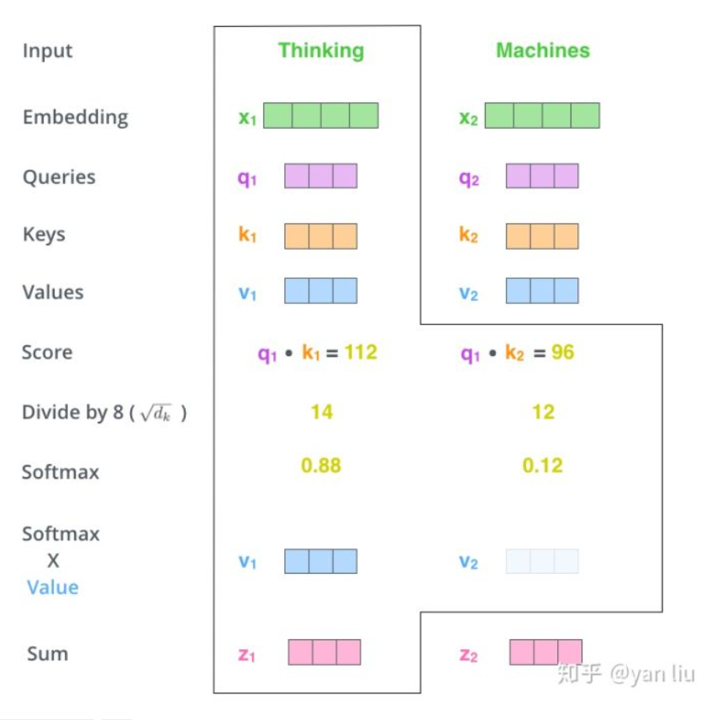
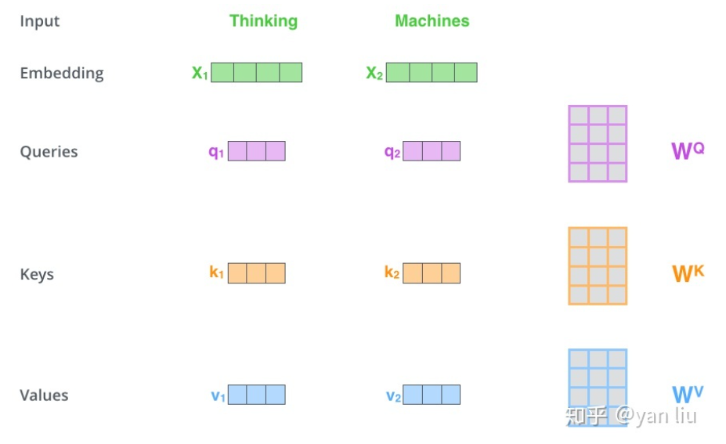
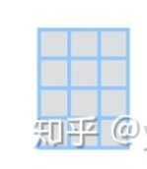
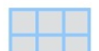

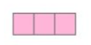

Introduction
《Attention Is All You Need》
Self-Attention：

Slide 8
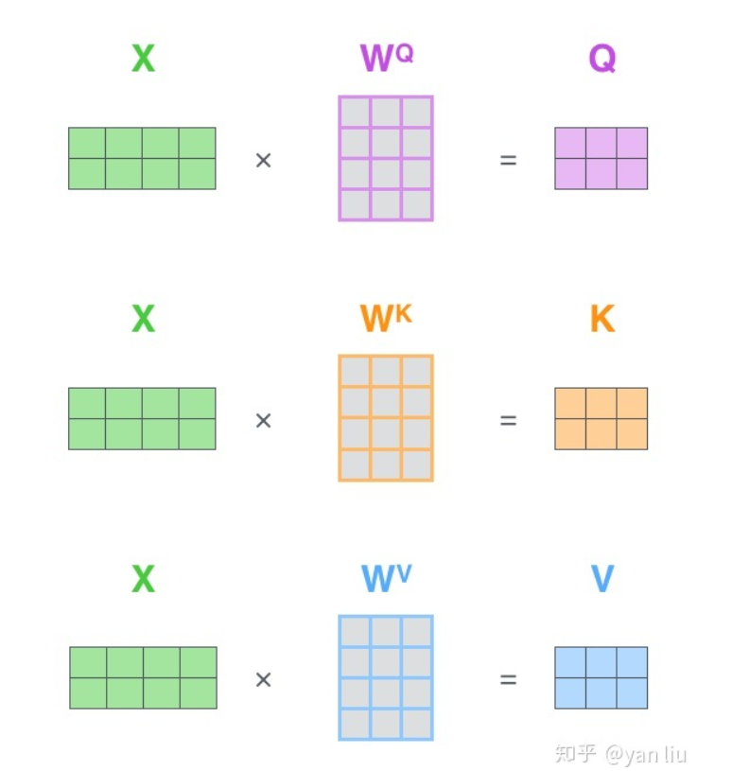
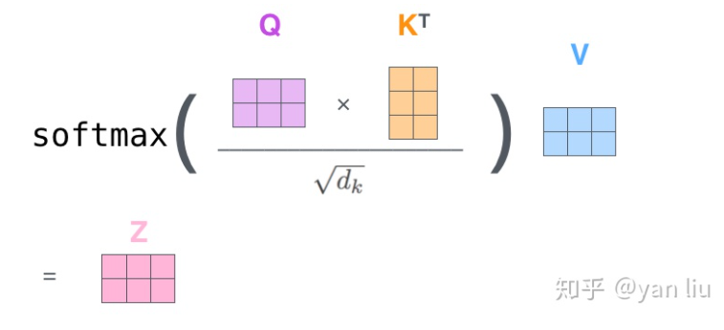


Introduction
《Attention Is All You Need》
Self-Attention：

Slide 9
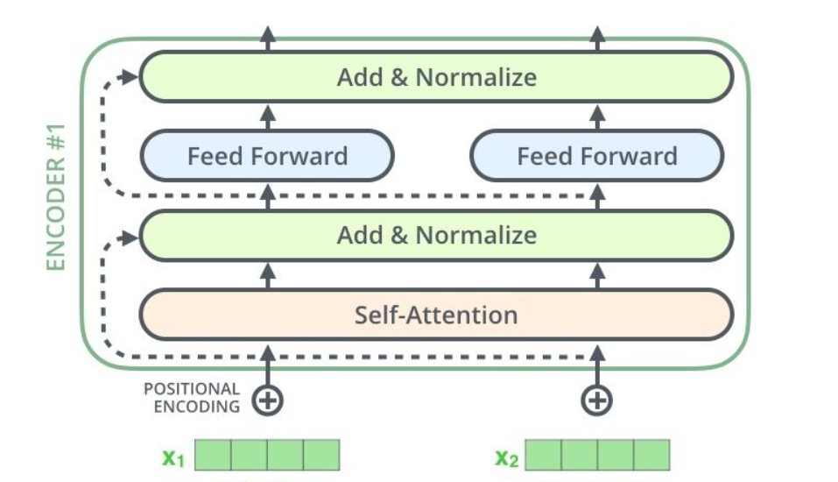
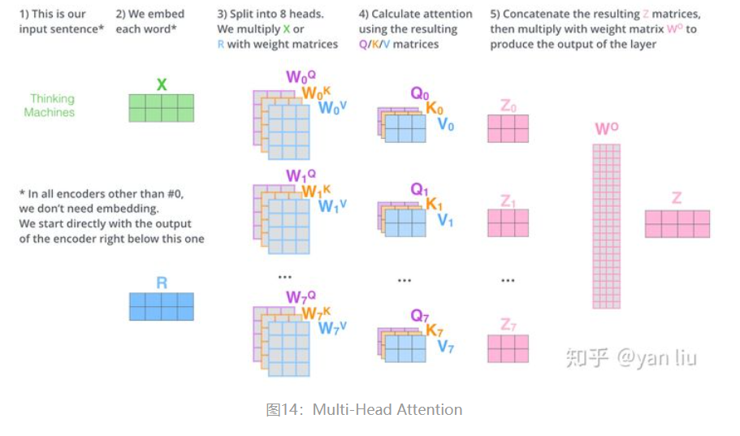

Introduction
《Attention Is All You Need》
Skip Connection：
Multi-Head：

Slide 10
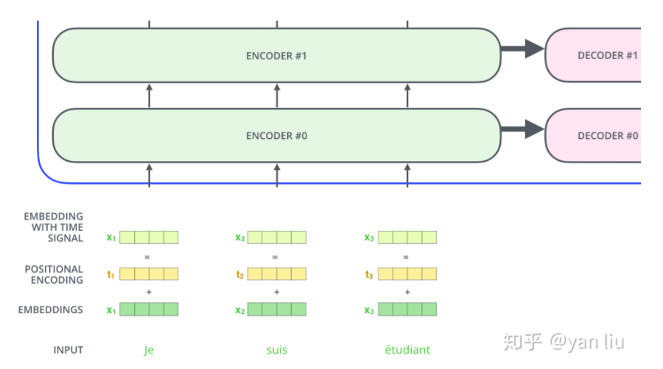
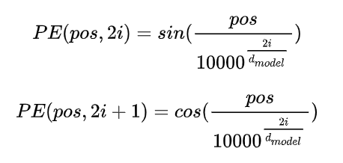

Introduction
《Attention Is All You Need》
Position Embedding：

Slide 11
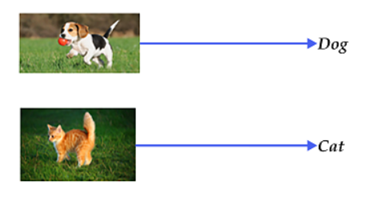
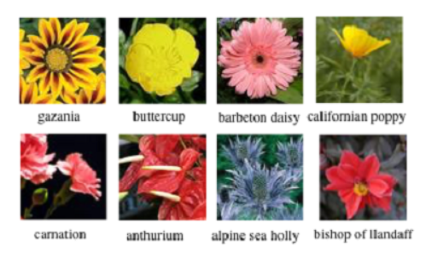
Image Classification：Introduction
General image classification
Fine-grained image classification

Slide 12
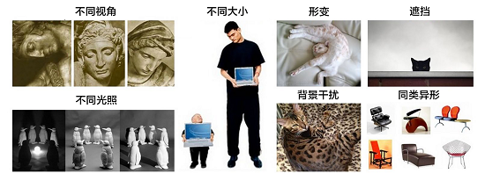
Image Classification：Challenge

Slide 13
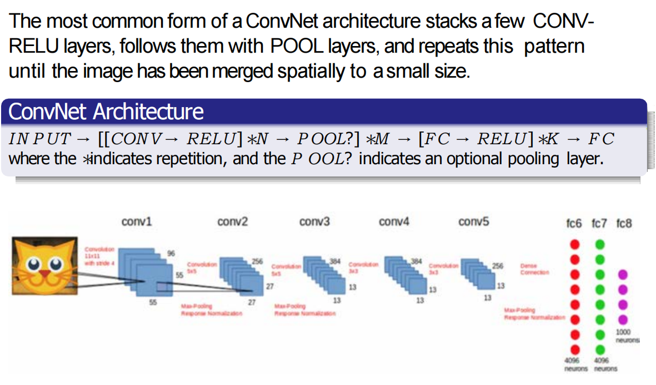
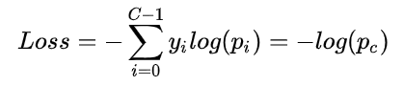
Image Classification：classical model

Slide 14

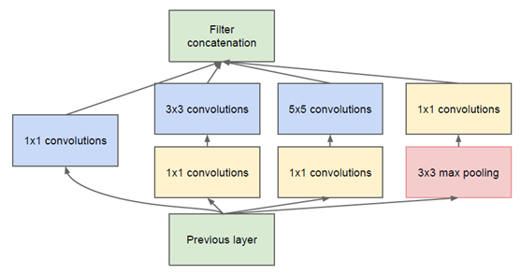
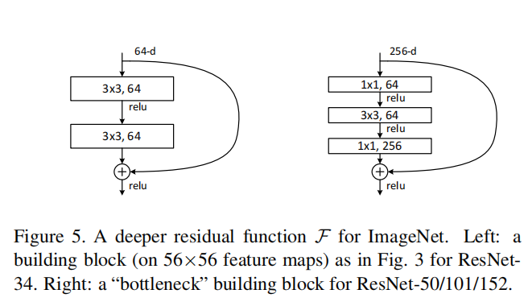
Image Classification：classical model
VGG：
GoogleNet：
ResNet：

Slide 15
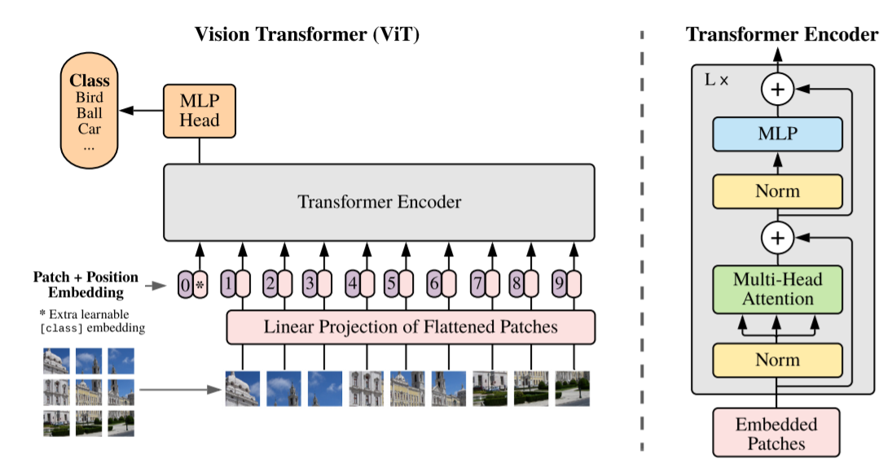
Image Classification：using transformer
《An Image is Worth 16x16 Words:Transformers for Image Recognition at Scale》

Slide 16
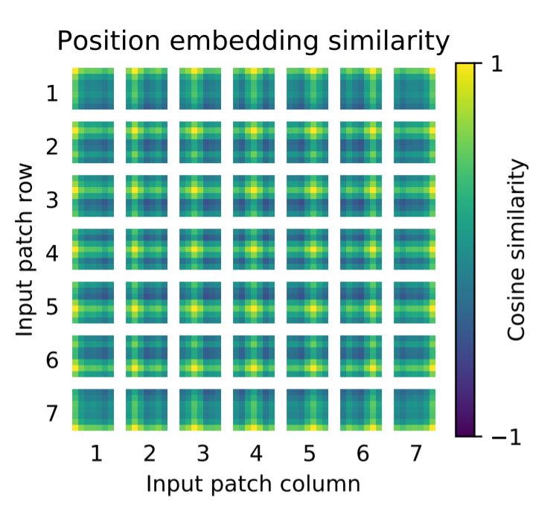
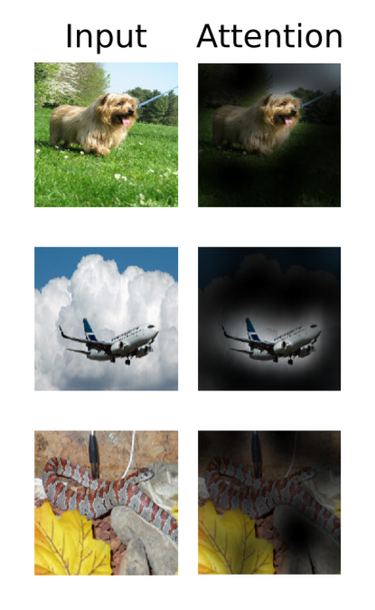
Image Classification：using transformer
《An Image is Worth 16x16 Words:Transformers for Image Recognition at Scale》

Slide 17
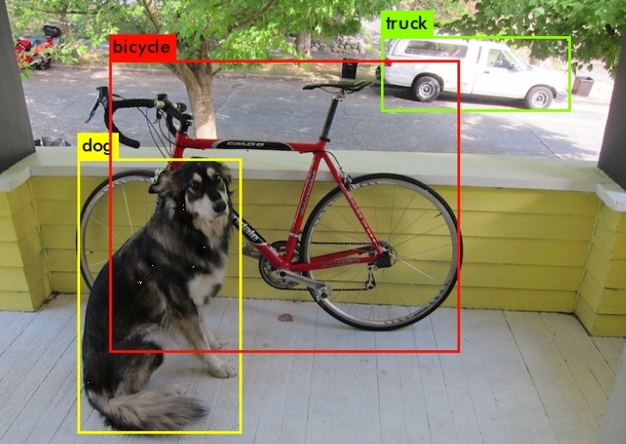
Object Detection：Introduction
Problems to be solved:
1. Positions
2. Classifications
3. Unordered set

Slide 18
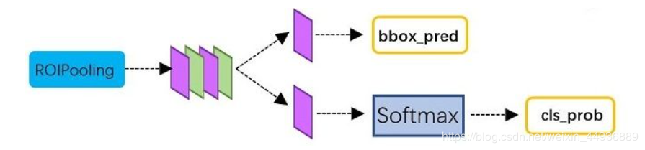
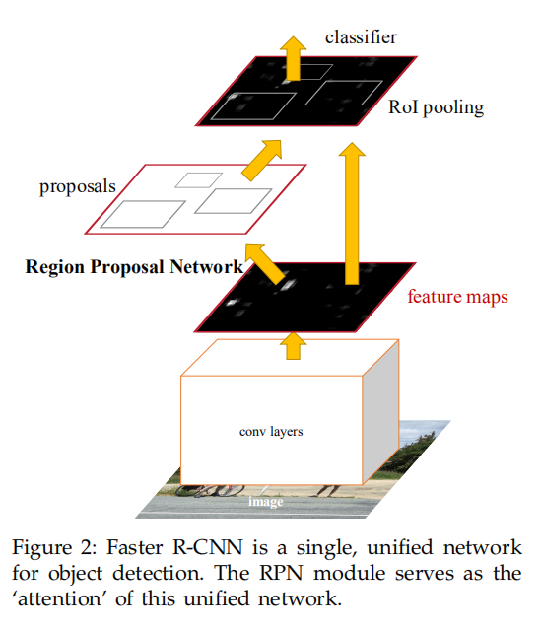
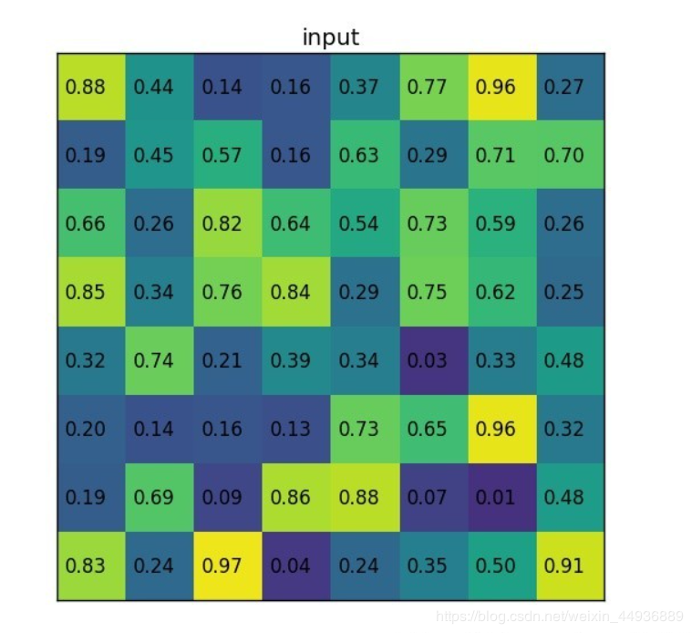
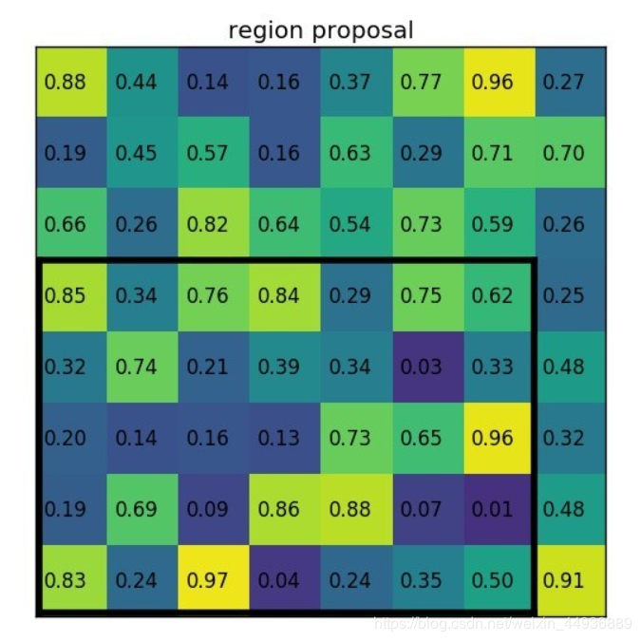
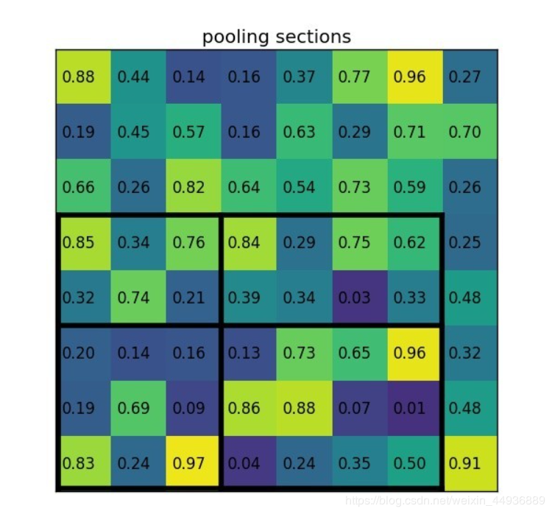
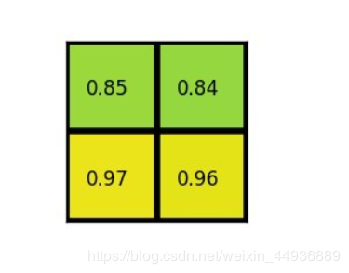
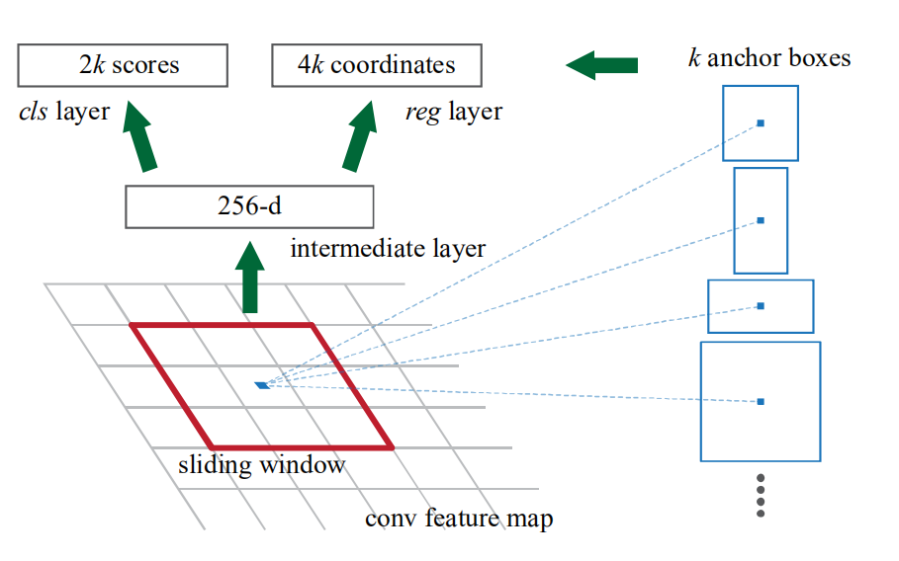
Object Detection：classical model
Faster-RCNN：

Slide 19
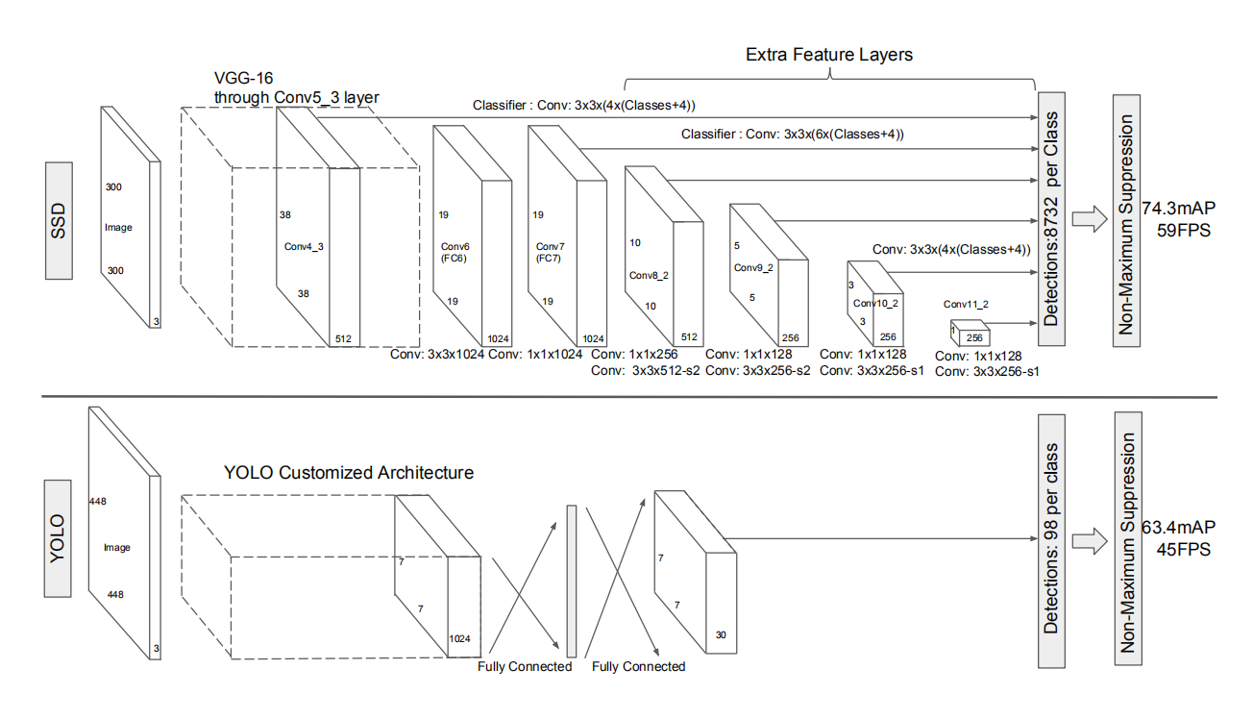
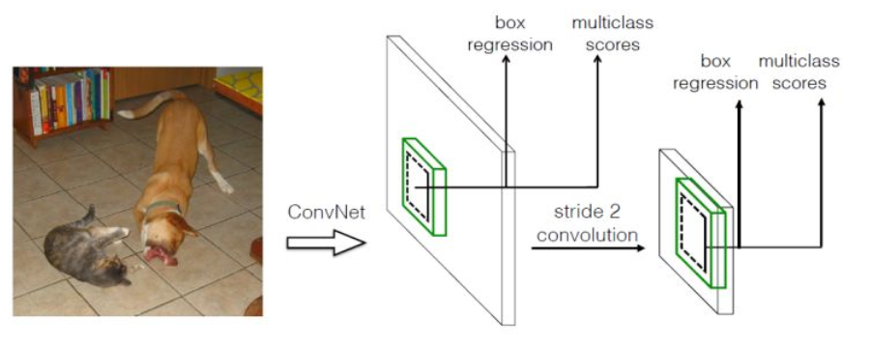
Object Detection：classical model
SSD & YOLO：

Slide 20
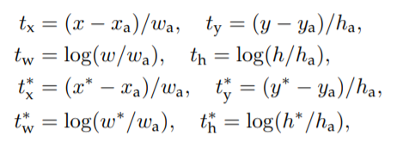

Object Detection：classical model
Loss Function：

Slide 21

Object Detection：using transformer
《End-to-End Object Detection with Transformers》

Slide 22




Object Detection：using transformer
《End-to-End Object Detection with Transformers》

Slide 23

Object Detection：using transformer
《End-to-End Object Detection with Transformers》

Slide 24

Semantic Segmentation：Introduction

Slide 25



Semantic Segmentation：classical model
FCN：

Slide 26

Semantic Segmentation：classical model
《Rethinking Semantic Segmentation from a Sequence-to-Sequence Perspective with Transformers》

Slide 27


Semantic Segmentation：classical model
《Rethinking Semantic Segmentation from a Sequence-to-Sequence Perspective with Transformers》

Slide 28
谢谢观看
有疑问的同学可以提问
分享人：梁瑛平

